Slide 1


E-Commerce Data Processing
Final project: Data Enginering track DEPI
Group Code: NEXT26_DKH1_AIS4_G1e Team: 2

Slide 2







Our Team
Abdallah Bassem
Asmaa Mohamed
Eman Mustafa
Hagar El-bayuomy
Mohamed Mahfouz
Mohamed Saad

Slide 3

Meeting Agenda
Business Questions
Data Modeling & Cleaning with SQL
Data Warehouse with powerBI
Data Visualization with powerBI
Recommendation
Q & A

Slide 4

Question 1
Business Questions
When is the peak season, month, day and hour of our ecommerce ?
Question 2
What is the preferred way to pay in the ecommerce?
Question 3
What is the total number of orders ?
Question 6
How many late delivered order in our ecommerce? Are late order affecting the customer satisfaction?
Question 4
What is the average spending time for user for our ecommerce?
Question 5
Question 7
What is the frequency of purchase on each state?
How long are the delay for delivery / shipping process in each state?

Slide 5



Data Processing
Data Modeling & Cleaning
Data Warehouse
Data Visualization

Slide 6
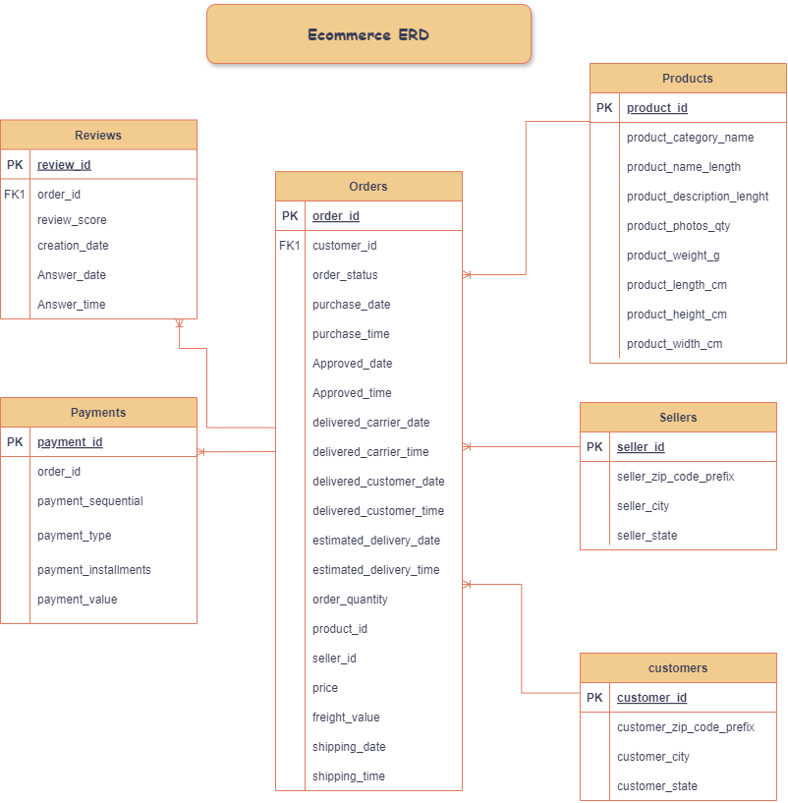
Data Modeling

Slide 7
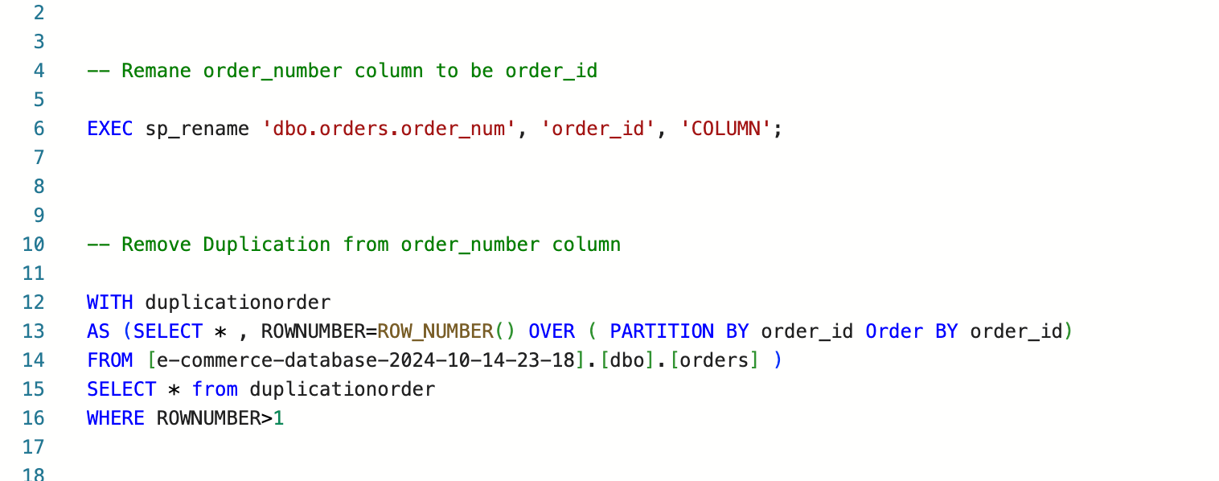
Data Cleaning with SQL

Slide 8
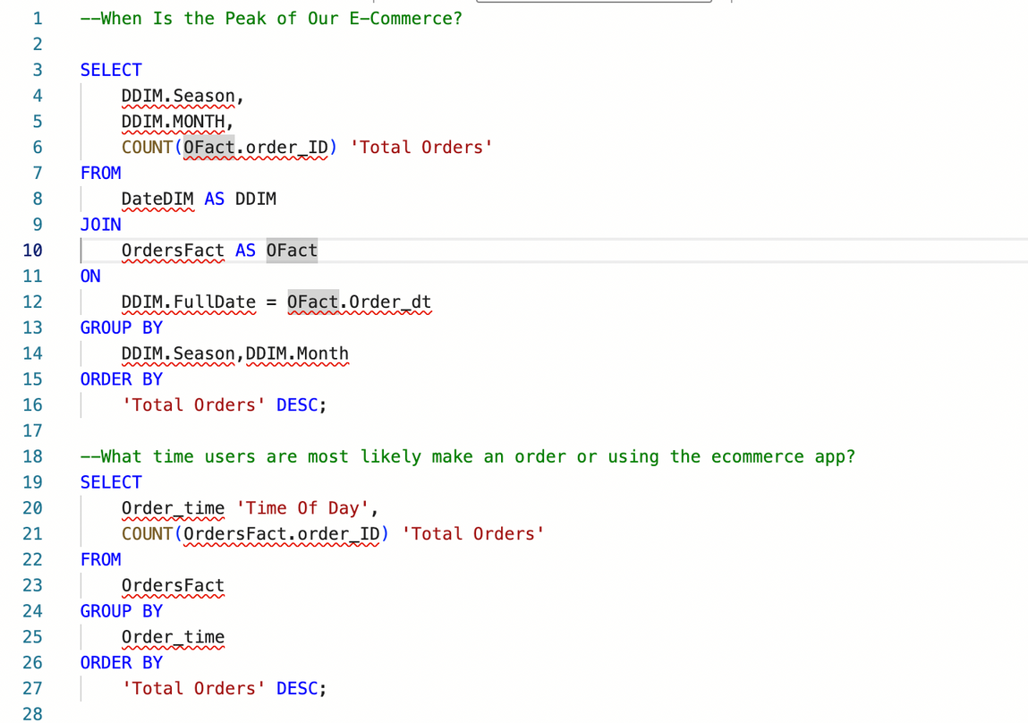
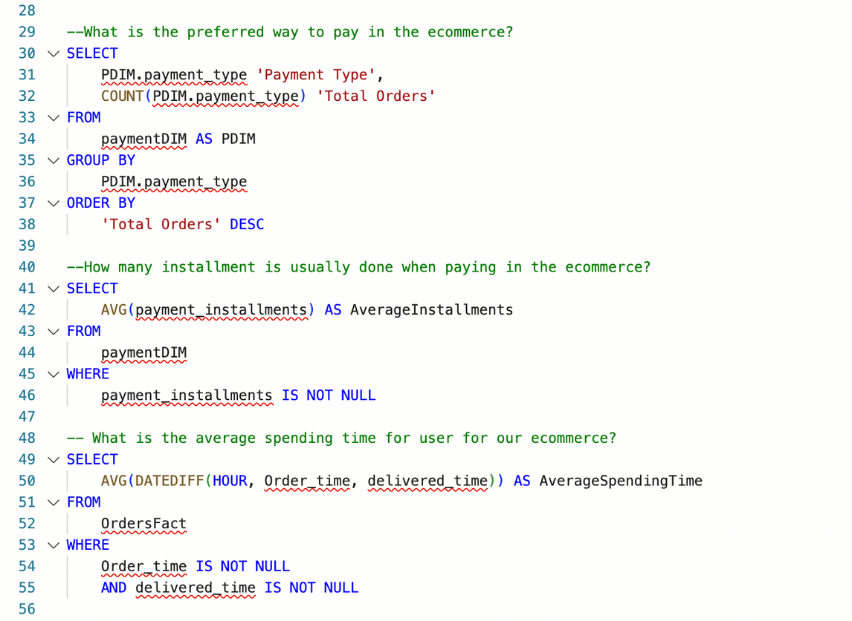
Data Warehouse with SQL

Slide 9
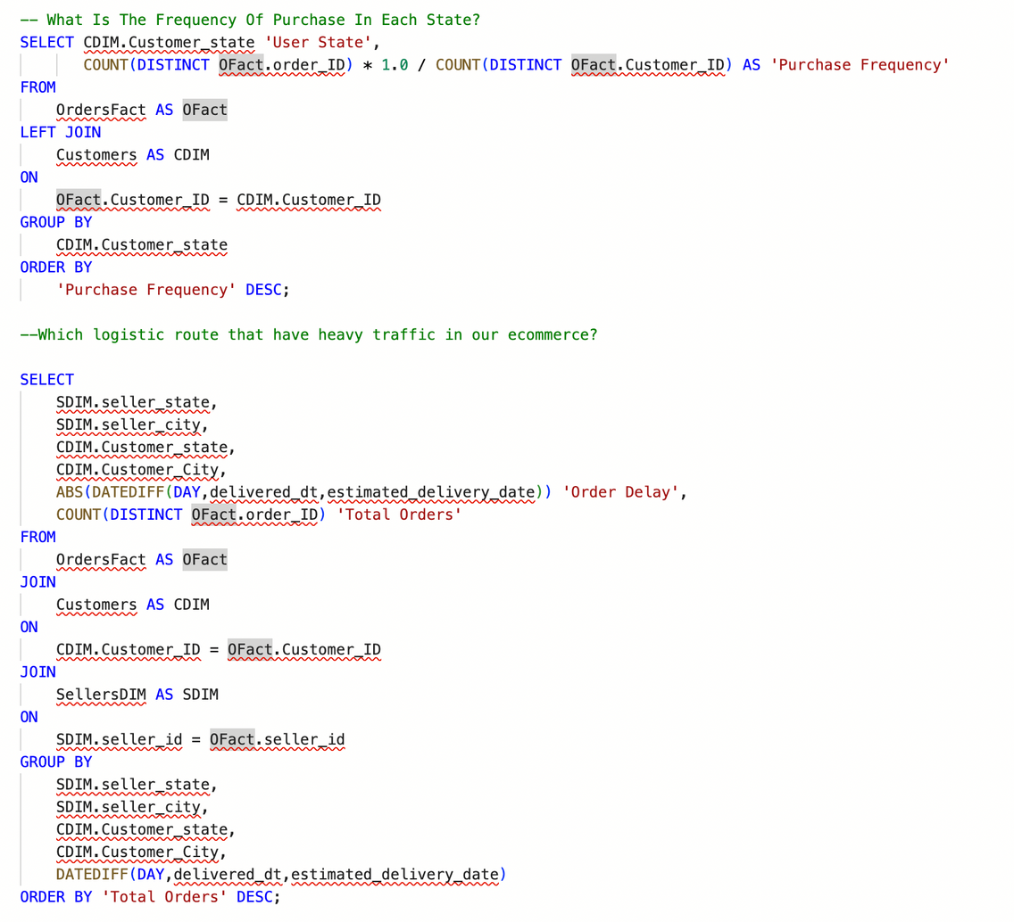
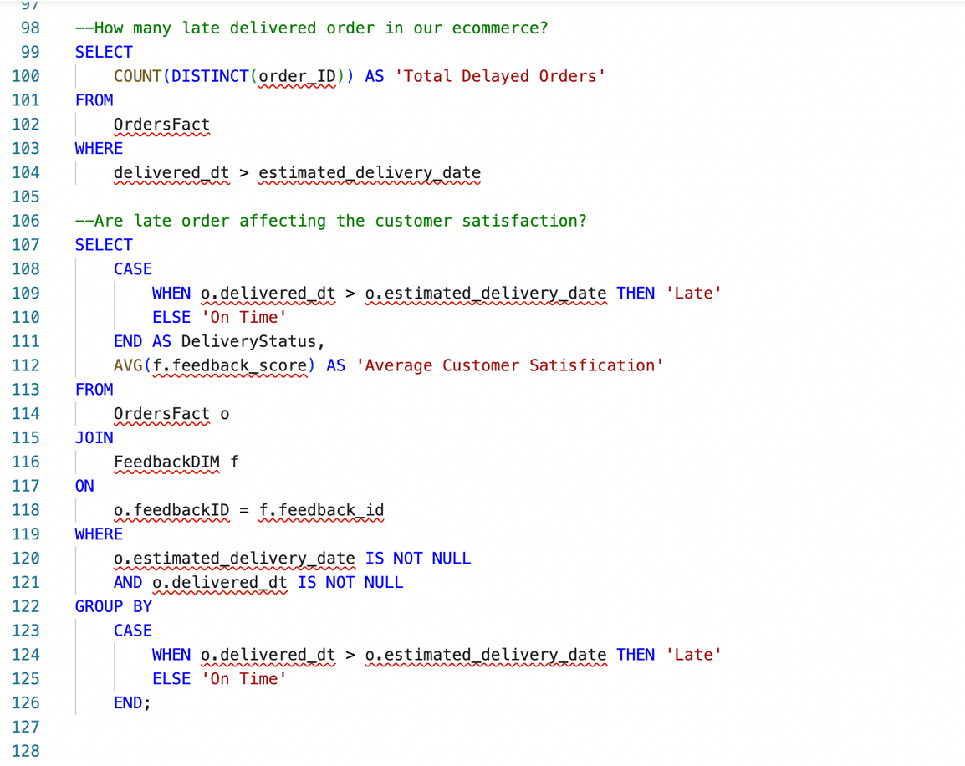
Data Warehouse with SQL

Slide 10
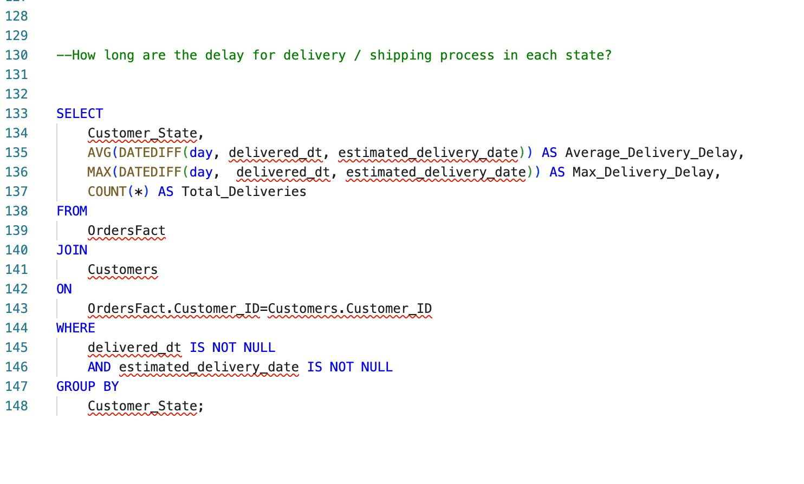
Data Warehouse with SQL

Slide 11
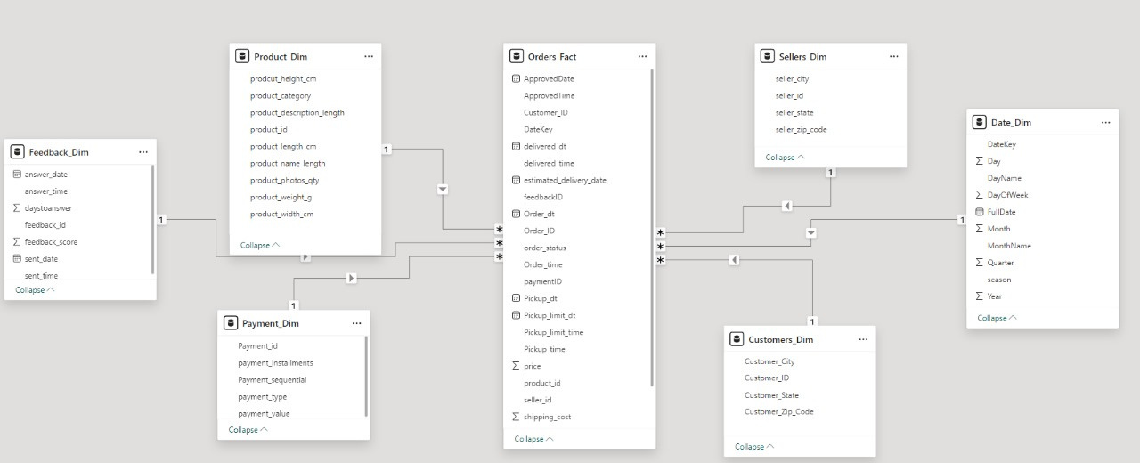
Data Warehouse With PowerBI

Slide 12
Dax with PowerBI
Total_Delayed_Orders
CALCULATE(COUNTROWS( Orders_Fact ),Orders_Fact[delivered_dt] > Orders_Fact[estimated_delivery_date])
Total_Orders CALCULATE(COUNT(Orders_Fact[Order_ID]),ALLEXCEPT(Date_Dim,Date_Dim[MonthName],Date_Dim[season],Date_Dim[DayName]))
PurchaseFrequency
DIVIDE(COUNTROWS(DISTINCT( Orders_Fact[Order_ID] ) ),COUNTROWS( DISTINCT( Orders_Fact[Customer_ID] ) ))

Slide 13
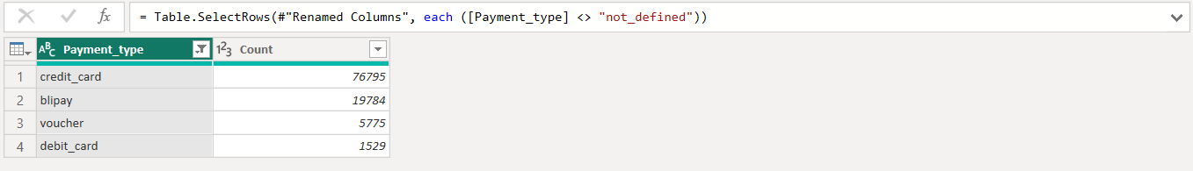
Power Query with PowerBI
= Table.AddColumn(#"Filtered Rows", "Case", each if [delivered_dt] = null or [estimated_delivery_date] = null then "Unknown"
else if [delivered_dt] > [estimated_delivery_date] then "Late"
else "On Time")
= Table.Group(dbo_FeedbackDIM, {"feedback_score"}, {{"Count", each Table.RowCount(_), Int64.Type}})

Slide 14
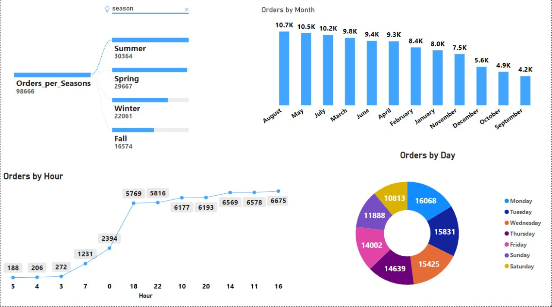
Data Warehouse With PowerBI
When is the peak season, month, day and hour of our ecommerce ?

Slide 15
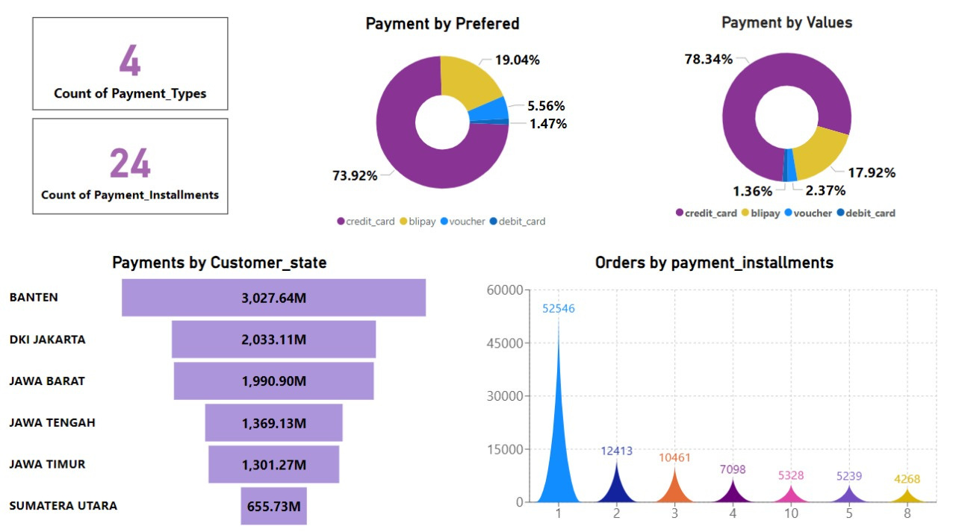
Data Warehouse With PowerBI
What is the preferred way to pay in the ecommerce?

Slide 16
Data Warehouse With PowerBI
What is the average spending time for user for our ecommerce?
What is the frequency of purchase on each state?
How many late delivered order in our ecommerce? Are late order affecting the customer satisfaction?
How long are the delay for delivery / shipping process in each state?
What is the total number of orders ?

Slide 17
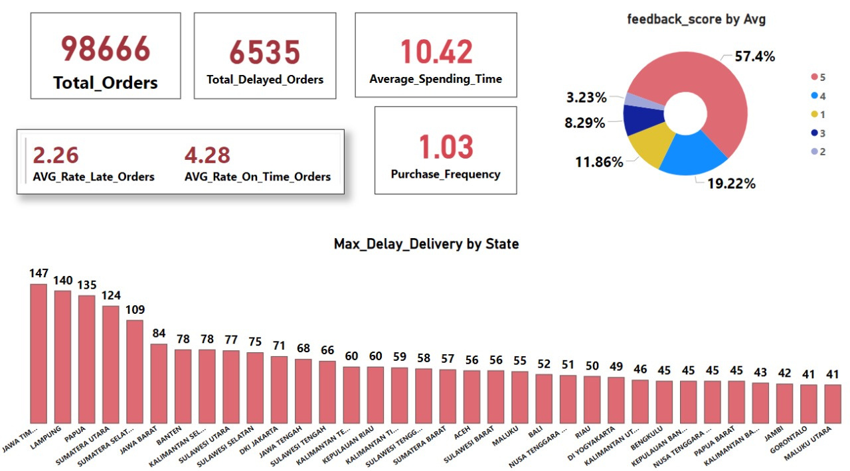

Slide 18
Recommendation
Peak Times
Payments
User Spending Time
Installments
1- Increase inventory and staffing
2- Offer exclusive deals or discounts
3- Optimize user engagement
4- Optimize app performance
1- Focus marketing efforts on preferred payment methods
2- Expand options for less-used payment methods
1- Offer flexible installment plans with more choices for different customers
2- Highlight installment plans prominently on the product page.
1- Improve user experience by simplifying navigation and checkout processes
2- Introduce personalized product recommendations

Slide 19
Recommendation
Purchase Frequency
Late Delivered Orders
Heavy Traffic Logistic Routes
Customer Satisfaction
1- Target marketing efforts & Promotions
2- Offer Loyalty Rewards
3- Create Subscription Service & Send E-mails
4- Know your Customers
1- Implement penalties or incentives for late deliveries
2- Communicate with customers offer compensation
1- communicate with customers about delivery delays
2-Track feedback from customers experiencing delays
1- Re-evaluate logistics routes
2- Partner with local couriers

Slide 20




What's the Question?
we are happy to answer you

Slide 21



